Slide 1
Periodic Table of Elements

Slide 2
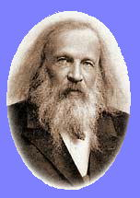
First Periodic Table
Dimitri Mendeleev ,a Russian scientists, developed the first periodic table in 1869.
Mendeleev intended the table to illustrate recurring ("periodic") trends in the properties of the elements.
Mendeleev arranged the elements according to their atomic mass.

Slide 3
Modern Periodic Table of Elements
Organized by the ATOMIC NUMBER, which is the number of protons
Horizontal rows = PERIODS
Vertical columns = GROUPS/FAMILIES
The main value of the periodic table is the ability to predict the chemical properties of an element based on its location on the table

Slide 4
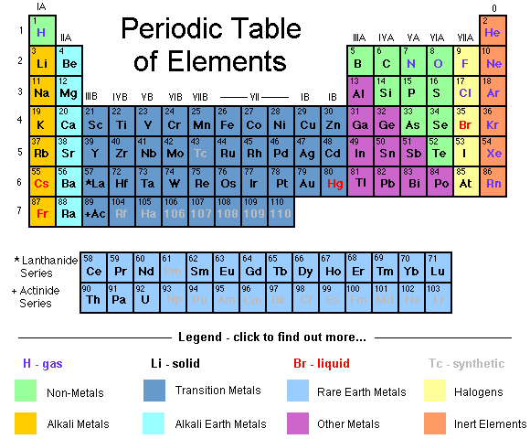

Slide 5
Periods – Organized In Rows
Periods

Slide 6


Slide 7
Horizontal Rows – PERIODS
All elements in a row have the same number of electron energy shells.
Number of Electrons increase from left to right
Atomic mass increases from left to right
Elements in a row have different chemical and physical properties.

Slide 8
Groups – Organized In Columns
Groups

Slide 9
Vertical Columns - GROUPS/FAMILY
All elements in a group have the same number of outer (valence) electrons
The elements in each group have very similar chemical and physical properties.

Slide 10
Basic Groups
Groups are considered the most important method of classifying the elements.
The Basic Groups are:
  Metals – toward the left side
  Non-metals – toward the right side
  Metalloids – in between metals and non-metals (properties of metals and non-metals) sometimes called ‘the staircase’

Slide 11
Major Groups
Groups are considered the most important method of classifying the elements.
Major Groups are:
Group 1 – Alkali Metals
Group 2 – Alkaline Earth Metals
Group 3 – 12 – Transition Metals
Group 17 – Halogens
Group 18 – Nobel Gases

Slide 12
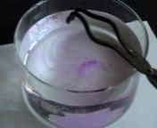
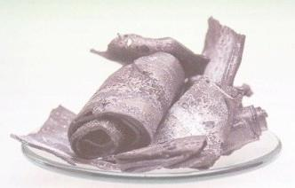
Group 1 - Alkali Metals
Li, Na, K, Rb, Cs, Fr are shiny, soft, low-melting metals. VERY REACTIVE METALS!!!!

Slide 13

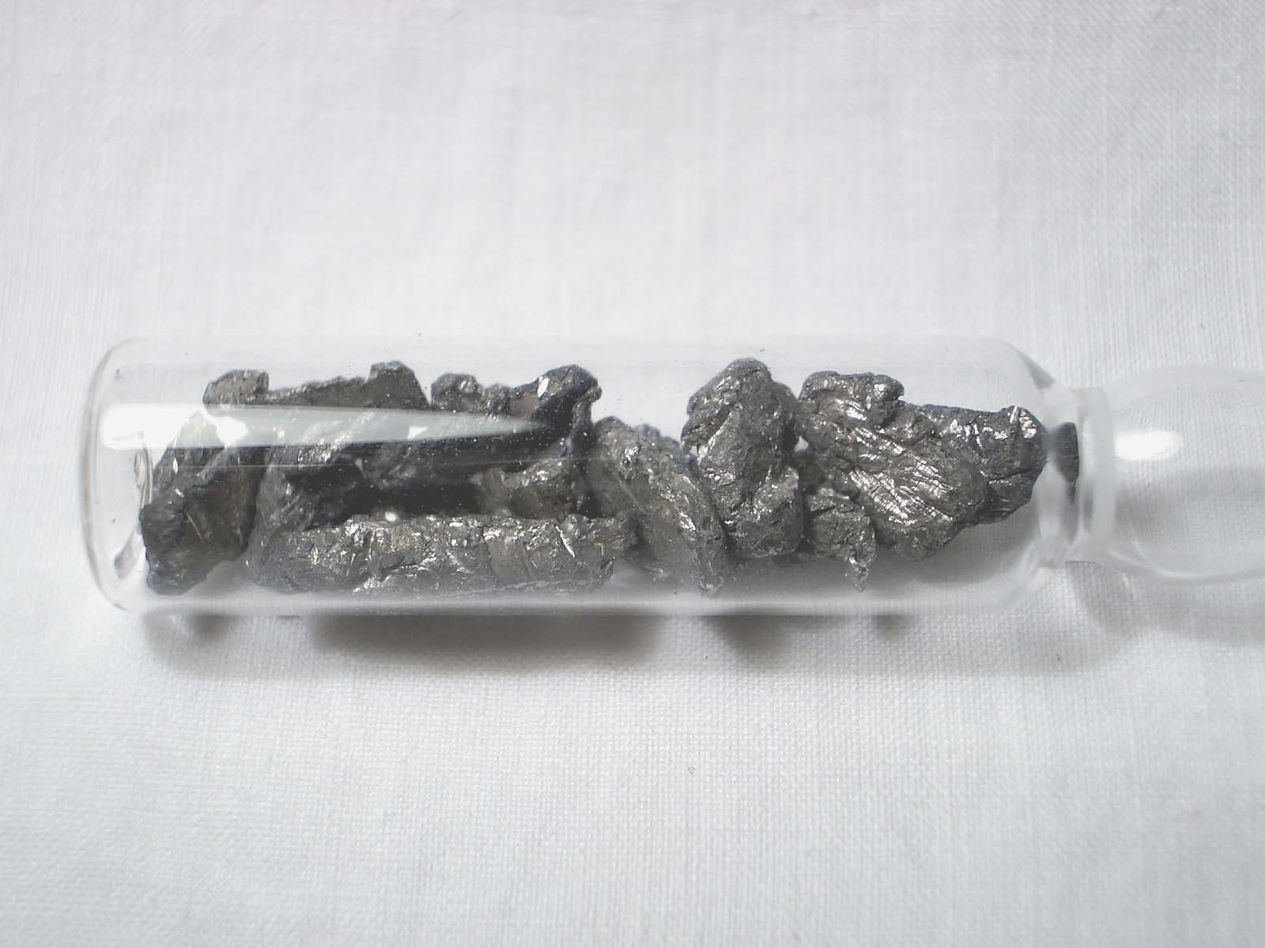
Group 2 – Alkaline Earth Metals
Be, Mg, Ca, Sr, Ba and Ra are lustrous metals but all are LESS reactive than their neighbours in group 1

Slide 14

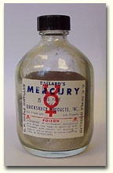
Transition Metals –
Groups 3 -12
The largest category of elements
All except mercury are solid at room temperature
Most have silvery shine and are generally malleable rather than brittle
Good conductors of heat and electricity

Slide 15

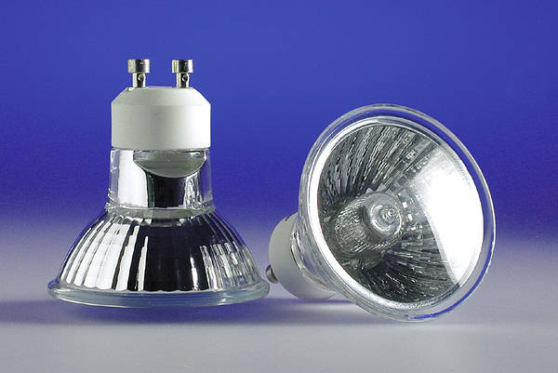
Group 7A - Halogens
F, Cl, Br, and I are corrosive and nonmetallic
Found as gases at room temperature
Found in nature in combination with other elements such as sodium, NaCl
Used in various products such as bleech or halogen lamps

Slide 16

Group 8A – Nobel gases

Slide 17
Nobel Gases
He, Ne, Ar, Kr, Xe and Rn are gases of very low reactivity
He, Ne and Ar do not combine with any other elements

Slide 18
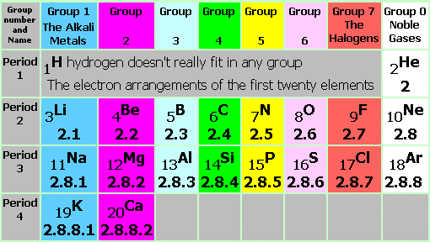
You must learn the FIRST 20 elements

Slide 19
VIDEO TIME
Simply Science Periodic Table video

